Slide 1




EService Desk Canvas App
Group Members:
Sarosh Jawed (20K-0362)
Basil Ali Khan (20K-0477)
Ammar (19K-1348)
Kainat Afzal (20K-0281)
Instructor:
Sir Mustajab

Slide 2
Overview
The EService Desk is a comprehensive platform designed to streamline and manage inquiries, support requests, and internal tasks within the university environment. Its primary purpose is to facilitate efficient communication between university employees (such as teachers, administrators, finance, HR, and IT staff) and support teams.
Key Objectives
Centralized Task and Inquiry Management.
Improved Communication.
Efficient Issue Resolution.
Task Allocation and Monitoring.
User-Friendly Interface.
Enhanced Efficiency and Productivity.

Slide 3
Problem Statement
In a university environment, the current system for managing inquiries, support requests, and internal tasks lacks a centralized and efficient solution. Various challenges and inefficiencies persist within the existing workflow, hindering seamless communication and task management among university employees and support teams.
Challenges
Disorganized Task Management.
Communication Gaps.
Lack of Transparency.
Data Silos and Inefficiencies.
Access Control Concerns.
Solutions
Centralized Task Management.
Improved Communication Channels.
Enhanced Transparency and Oversight.
Efficient Data Management.
Robust Control Measures.

Slide 4
Solution Design
Technical Architecture
Canvas App Development: Develop the EService Desk using Power Apps, ensuring a user-friendly interface for seamless navigation and task management.
SharePoint Integration: Utilize SharePoint as the primary data source for storing and managing tables like tbl_tickets and AssignedUser. Leverage SharePoint's capabilities for data storage, access control, and versioning.
Datasource
tbl_tickets Table: Index_id, Department, Assigned_to, Comment, Subject, Description, Status, Priority, Owner, Created Date, Closed Date, Created By.
AssignedUser Table: Index_id, Email, Name, Department.

Slide 5
Solution Design (Contd.)
User Roles and Access Control
Admin Role:
Create and assign tasks.
Comprehensive visibility of all tasks/issues, irrespective of department.
Manage user access and permissions.
Departmental Employees:
Create, view, and manage tasks specific to their respective departments.
Limited access to tasks/issues outside their department for data confidentiality.
Workflow and Functionalities
Task/Issue Lifecycle:
Creation -> Assignment -> Status Update -> Resolution.
Informed about task updates or pending actions.
Task Assignment Logic:
Logic for task allocation based on priority, and departmental responsibilities.
Allow admins to assign tasks manually.

Slide 6
Workflow
The workflow begins when a task or inquiry is created within the EService Desk app.
Task/Issue Creation
Users (Admin or Departmental Employees) create a task/inquiry by providing necessary details like subject, description, priority, and department.
Assignment Stage
For Admin: Receives the task/inquiry and can manually assign it to the appropriate department or individual.
For Departmental Employees: Task/inquiry gets automatically assigned based on admin or departmental allocation.
Monitoring
Assigned user(s) and Admin can monitor the task status, track progress, and provide updates/comments within the EService Desk app.
Status Update
Users update the task status as it progresses through different stages (e.g., open, in progress, on hold, closed).
Resolution
Once the task is resolved, the user marks it as closed or completed within the system.
Closure and Reporting
Task closure triggers automatic closure date recording.
Task data is stored in the SharePoint database for reporting and analysis purposes.
The workflow concludes upon task closure, and the system is ready for new tasks or inquiries.

Slide 7
Elements, Components and Functions
Containers: to group and arrange element controls together within an app for layout structuring.
Gallery: Display control presenting data from a data source, allowing various layouts for showing records or items.
Buttons: Interactive controls triggering actions or navigation within the app upon user clicks or taps.
Icons: Visual cues representing actions, categories, or functionalities within the app for intuitive user interaction.
Images: Display elements showcasing visual content such as pictures or graphics to enhance user experience.
Labels: Text elements for providing context, descriptions, or captions in the app's interface.
Text Inputs: Controls enabling users to enter and edit textual data within the app, such as textboxes or input fields.
Dropdowns: Interactive controls offering a list of options for users to select from within the app interface.

Slide 8
Elements, Components and Functions (Contd.)
ClearCollect(): Creates a collection and clears any existing data before adding new data from a data source.
Set(): Assigns a value to a variable or a control property within the app.
Navigate(): Transitions the user to a different screen within the app or opens a web link or email.
Patch(): Modifies or creates a record in a data source, applying changes to specific fields.
First(): Retrieves the first record from a table or collection that meets specified conditions.
Sort(): Arranges records in ascending or descending order based on specified columns or criteria.
Defaults(): Returns the default value for a data card or a control within a form.
Notify(): Displays a notification message to the app user with information or alerts.
Lookup(): Searches for a single record in a data source based on specified criteria.

Slide 9
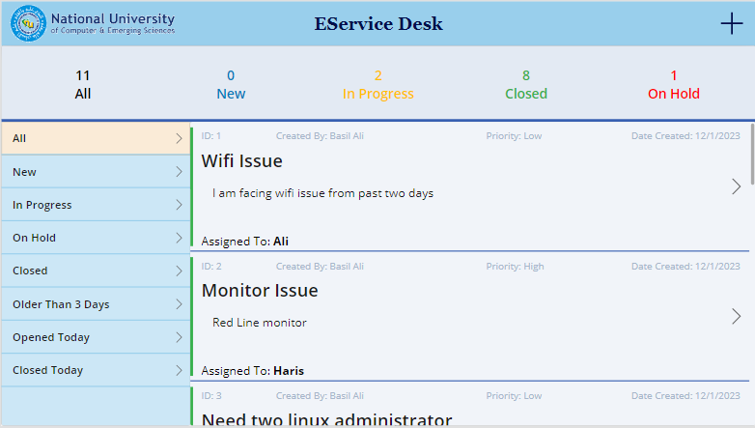
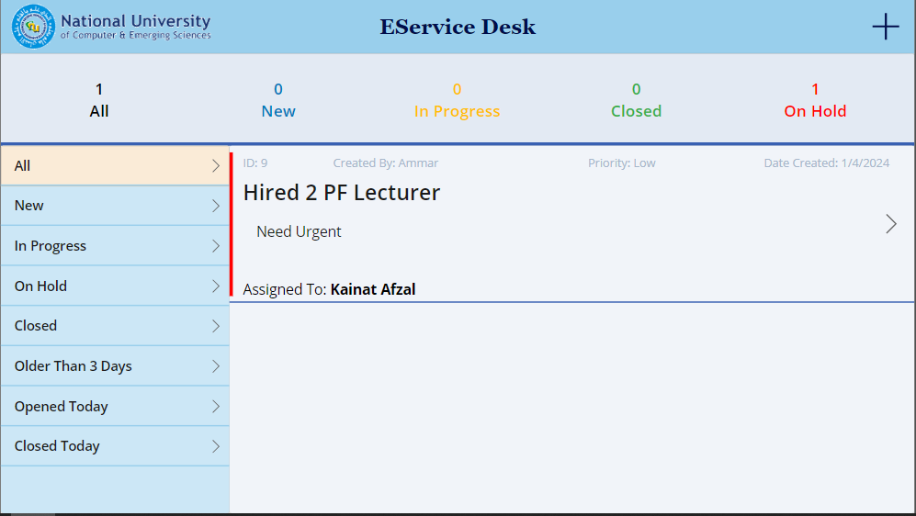
Slide 3
User Interface and Functionalities
1
2
Admin view of task/issue/request assigned.
Employees View of task/issue/request assigned.

Slide 10
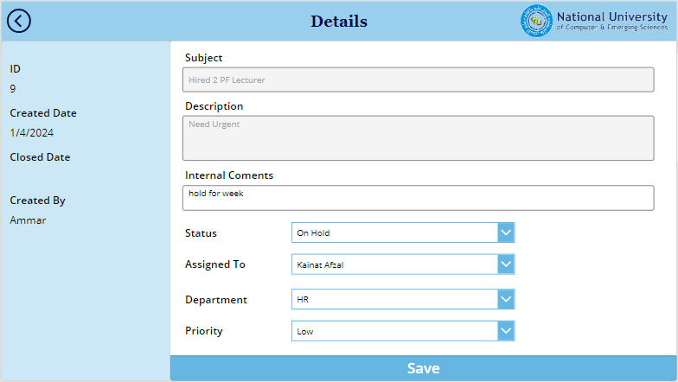
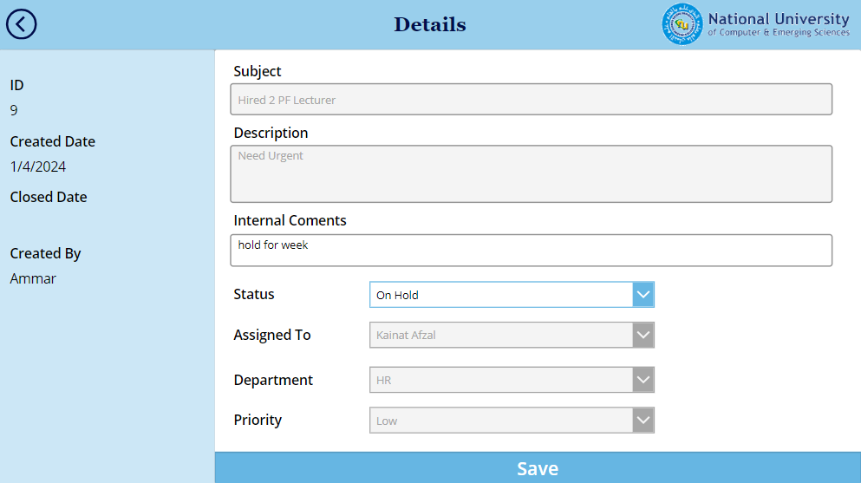
Slide 3
User Interface and Functionalities (Contd.)
3
4
Admin view of task/issue/request assignment to designated employee and department.
Employee view of task/issue/request details and its updating.

Slide 11
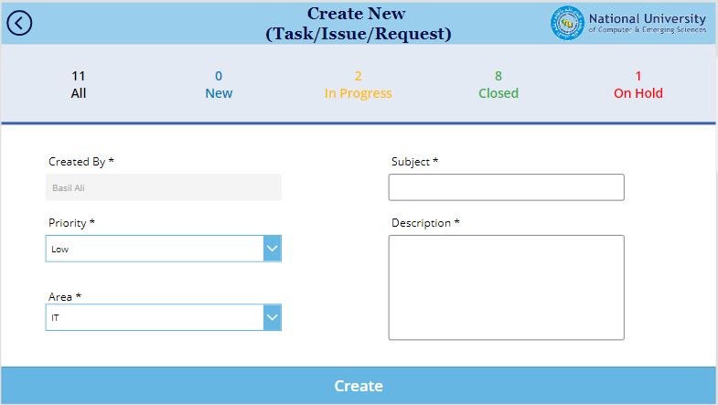
Slide 3
User Interface and Functionalities (Contd.)
5
Admin and Employees View of task/issue/request creation.

Slide 12

Q&A

